Slide 1
DCM workshop
Part 1
Timerseries extraction
First-level DCM model
David Willinger

Slide 2
Workshop
Today (Nov 10)
Some backgound on effective connectivity analysis
How to identify functional networks
How to extract time series information
How to build a first-level DCM
Review model fit and explore DCM.mat struct

Slide 3
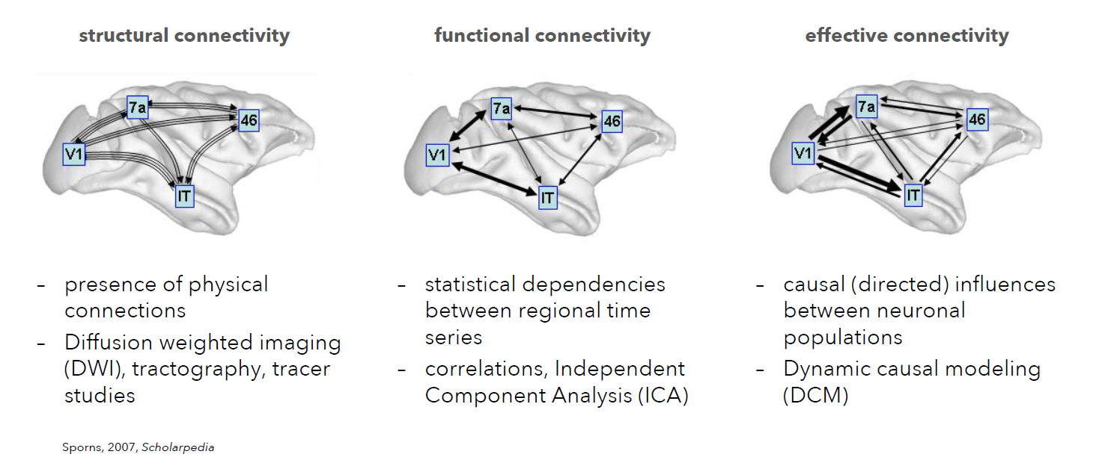
Background

Slide 4
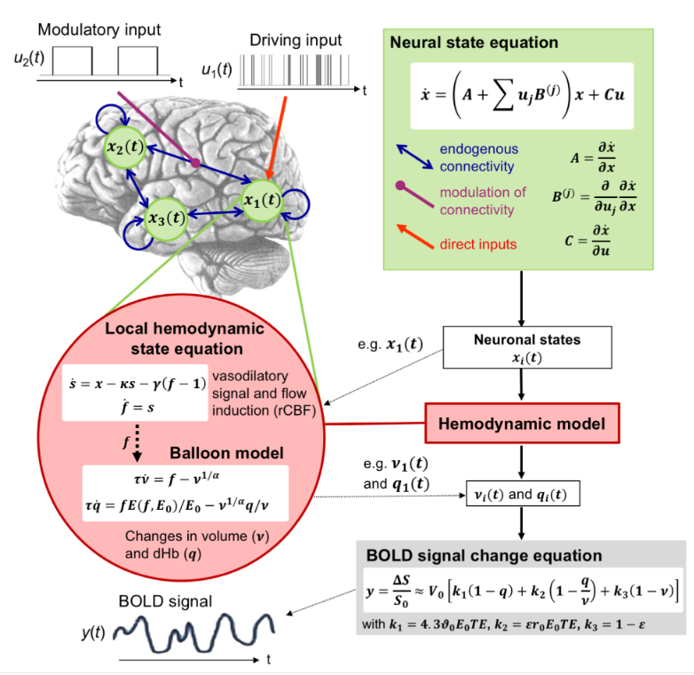
Background
DCM analysis looks at this
    Dynamic causal modelling
„How does change of activity in region A affect region B?“
Parameter matrices A, B and C
GLM analysis usually looks at this

Slide 5
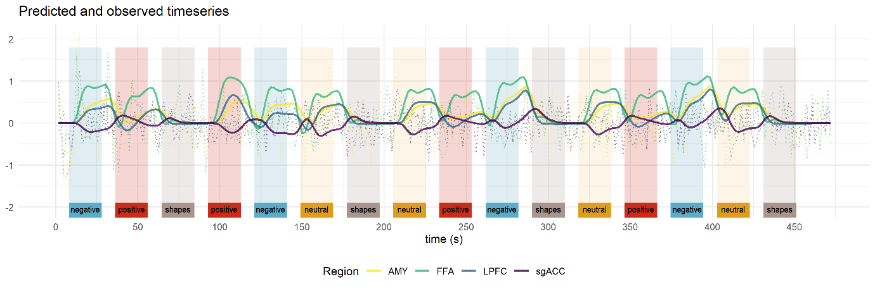
Background
    Dynamic causal modelling
Example (face matching):

Slide 6
Background
    Dynamic causal modelling
A … „intrinsic / average connectivtiy“
→ Represents the average connectivity during the task („intercept“)
B … „modulatory parameters“
→ B matrix can model additive connectivity changes for a condition
C … driving input
→ Generally, we will use an „all events“ regressor as input
D … non-linear connectivity changes of one region between others
→ extension of B-matrix to explicitly model „source region“
This is typically supplied via an SPM.mat (GLM model)

Slide 7
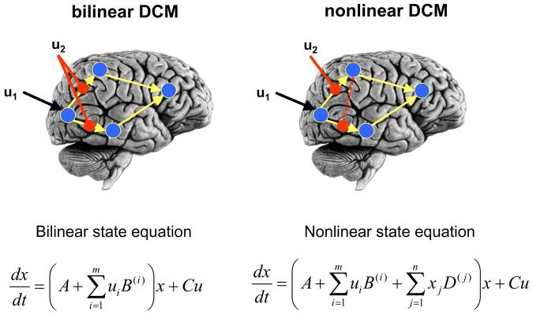
Background
    Dynamic causal modelling
Stephan et al., 2008

Slide 8
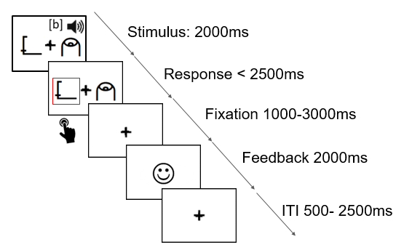
DCM Example: Task
          AllRead
          Associative learning task
          Analysis contains two runs
          Reinforcement learning model captures learned association strength (values 0-1)
Notes:
Subjects are presented with a sound and a symbol at the same time. They need to learn whether the association is correct or not, they get feedback after each try.

Slide 9
Sample
from the 99 kids:
  Movement 4 no good block, 10 only 1 good block => -14, To good performers (0 error): -5
  80
Groups
  27 poor (<16 SLRT)
  42 typical (>25 SLRT)
  11 gap (in between)
  Demographics
aged 8.9 ± 0.74 years (group difference)
44 male, 36 female
SLRT whole group: mean 40.35 ± 42.12
27 poor SLRT mean: 5.01 ± 4.25, 42 typical SLRT mean: 58.57 ± 21.53
8 left handed
nonverbal IQ: 105.1 ± 7.01 (no significant groups difference)

Slide 10

SPM

Slide 11
Prerequisites 1: Identify your hypothesis
DCM is not good in exploratory analysis
We need to formulate hypotheses and networks we are interested in a priori
Typically:
      How is connectivity modulated by condition A vs B
      How do groups differ in connectivity
      How does connectivity vary with a covariate
Notes:
So what is the purpose of using effective connectivity models? They can give insight into the information flow in a network and can tell us how information is integrated – during tasks or resting-state. Models of effective connectivity, i.e. the causal influences that system elements exert over another, are essential for studying the functional integration of neuronal populations and for understanding the mechanisms that underlie neuronal dynamics (Friston, 2002a; Horwitz et al., 1999).
So why go to the trouble of creating realistic models of brain processes? Basically, because it allows one to compare different models or hypotheses about distributed neuronal computations generic approach for inferring hidden (unobserved) neuronal states from measured brain activity

Slide 12
Prerequisites 2: Identify your network
Goal: reveal the brain regions that are related to the task, such that we can extract the timecourse
    If a GLM analysis does not show activity in a region for any contrast, there is no motivation to include it in a DCM analysis → nothing to explain by our model
    Our example:
      Is connectivity between regions supporting audiovisual integration affected by learning?
      Do poor readers and typical readers differ?

Slide 13
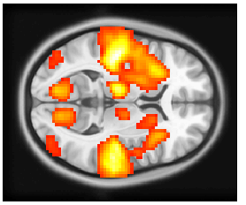
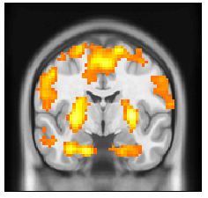
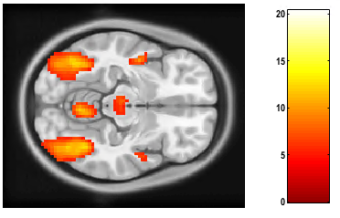
DCM Example: Identify your network
Main effect of audiovisual stimulus
Effect of associative strength (AS)
AUC
PUT
STS
VWFA
den Ouden et al. (2010); Li et al. (2017, 2019)
Notes:
AUC = Responds to sounds, auditory stimuli
STS = Their results showed that the bilateral superior temporal gyrus/middle temporal gyrus (STG/MTG) was involved in the integration of the visual stimulus with both informative and uninformative sounds
VWFA = The authors suggested that the right LOC was modulated by the temporal relationship within the audiovisual stimulus and formed an audiovisual memory, resulting in high-level multisensory integration—which is a process related to experience, properties of the stimulus, and task content—and enhancement of behavioral responses (Li et al., 2017). , and the right lateral occipital complex (LOC) was activated more strongly by the audiovisual stimulus compared to visual input alone in the informative sound condition.
Associative strength = regions where BOLD signal is modulated by how well the phoneme-grapheme association has been established.
PUT = learning, constraint anatomically

Slide 14
Step 1: Timeseries extraction
Goal: Extract the timeseries from all regions for all subjects
This multivariate timeseries will be data to be modeled!
Important:
      Contains only signal from voxels with at least some degree of experimental effect (puncorr. < 0.05)
      Can be constrained functionally and/or anatomically
      Size of regions depends on structures investigated and smoothing kernel! Rule of thumb (radius ~ smoothing kernel ~ 6-8mm)
    After extraction check for subjects that do not show activity in single regions → will have to be excluded

Slide 15
Step 2: Create GLM for DCM
Goal: Create a model for DCM analysis (separate SPM.mat)
Includes all regressors that enter the DCM
Usually simpler than GLMs of activity analysis
If we have multiple sessions, we need to concatenate them
Notes:
Show how to concatenate

Slide 16
Step 3: Create DCMs
Goal: Create a model for DCM analysis based on previously created SPM.mat (results in a DCM.mat)
Stores information about model inputs, priors of connectivity and haemondynamic parameters, timing, onsets, …
Connectivity priors → do I have prior knowledge of connections?
Task modulations
Model input = where does TASK enter? (“ping the network”)

Slide 17
DCM example: Assessment of first-level results
  spm_dcm_fmri_check

Slide 18
DCM example: Assessment of first-level results
  spm_dcm_review

Slide 19
DCM example: Assessment of first-level results
  DCM (or HCM) struct
Field | Description
DCM.xY | ROI information (coordinates, timecourse, ..)
DCM.{a,b,c,d} | Priors of the DCM
DCM.Ep.{A,B,C,D} | Posterior means of DCM parameters
DCM.Pp.{A,B,C,D} | Posterior probabilities of DCM parameters
DCM.F | Free energy
DCM.AIC | Akaike Information Criterion
DCM.BIC | Bayesian Information Criterion

Slide 20
DCM workshop
Part 2
- Second-level PEB model
- Assessment of results
- Questions
David Willinger

Slide 21
DCM example
  Where we are: estimated first-level
AUC
STS
PUT
Associative
strength
VWFA

Slide 22
DCM: group study
We will follow the workflow described in Zeidman et al. (2019), using the Parametric Empirical Bayes (PEB) framework
What are the commonalities in effective connectivity across subjects within a group or differences between groups?
Which combination of connections best predicts a group difference (or covariate)?
Notes:
So what is the purpose of using effective connectivity models? They can give insight into the information flow in a network and can tell us how information is integrated – during tasks or resting-state. Models of effective connectivity, i.e. the causal influences that system elements exert over another, are essential for studying the functional integration of neuronal populations and for understanding the mechanisms that underlie neuronal dynamics (Friston, 2002a; Horwitz et al., 1999).
So why go to the trouble of creating realistic models of brain processes? Basically, because it allows one to compare different models or hypotheses about distributed neuronal computations generic approach for inferring hidden (unobserved) neuronal states from measured brain activity

Slide 23
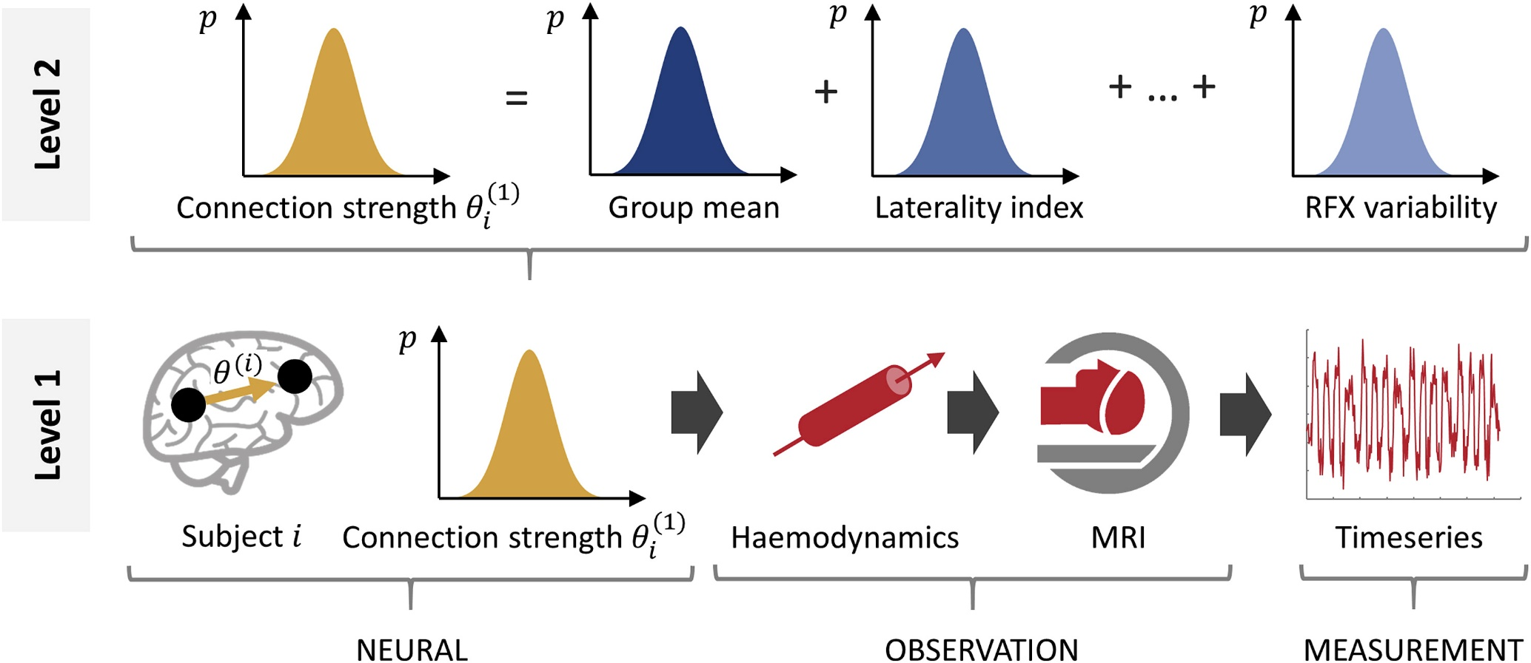
Group analaysis in the PEB framework
Zeidman et al. (2019), NeuroImage
Notes:
Last workshop we focused on the first-level analysis, recap.
In brief, it uses an estimation scheme called Variational Laplace (Friston et al., 2007) that tunes parameters (e.g. connection strengths) with the objective of making the predicted neuroimaging timeseries match the observed timeseries as closely as possible, while penalizing movement of the parameters away from their prior values.
Ideal compromise between accuracy and complexity is the free energy F1.
The first level analysis (detailed in the companion paper) involves designing an architecture for each subject's model, i.e. deciding which brain regions to include, selecting which connections should be informed by the data, and selecting which connections can be modulated by the experimental manipulations.
But what we are interested now is: how to perform efficient analysis on the second level with the help
The second level analysis involves deciding which parameters to treat as random effects, i.e. sampled from the population, and including these in the PEB model. Typically, only the parameters that are relevant to the hypotheses will be included in the group analysis, and for task-based DCM studies these will primarily be matrix B of the DCM neural model, quantifying the modulations of connections by each experimental condition.

Slide 24

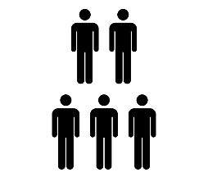

DCM with PEB
First-level
$$Y_{i}=Γ_{i}\left(θ_{i}^{\left(1\right)}\right)+X_{0}β_{i}+ε_{i}^{\left(1\right)}$$
Full model - Inversion with VB
Nested models – BMR
BOLD timeseries
DCM
Effects of no interest (e.g. mean)
Second-level
Group effects
Between-subject error
$$θ_{i}^{\left(1\right)}=Xθ^{(2)}+ε^{(2)}$$
DCM param.
Group-level design matrix
Expected values
Covariance matrix
$$θ^{(2)}=η+ε^{(3)}$$
Fixed group priors
Notes:
First level – inversion results in Free energy for full model; Free energy of the nested models can be obtained with Bayesian model reduction
Hierarchical model (resembles the summary approach many people here will be already familiar with)

Slide 25
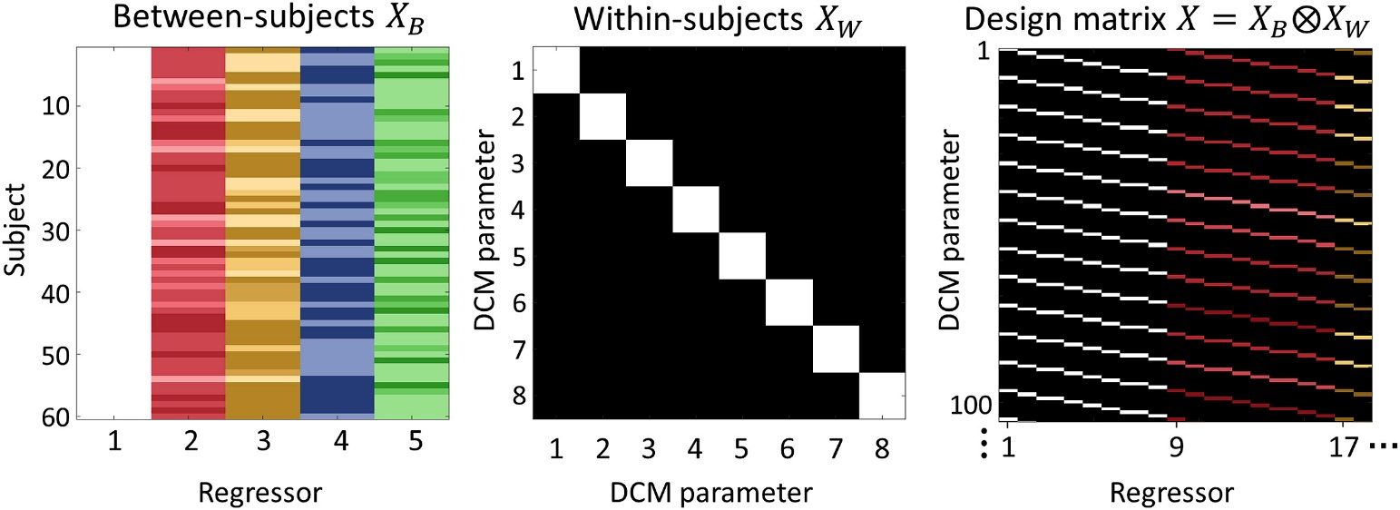
PEB: Design Matrix Specification
Mean
Covariates (e.g. age, sex, behavioural scores)
$$θ_{i}^{\left(1\right)}=Xθ^{(2)}+ε^{(2)}$$
Output: One estimate for each covariate and each parameter
Notes:
Left: the between-subjects design matrix, with regressors (covariates) modelling the group mean, laterality index, handedness, gender and age. Middle: the within-subjects design matrix, where the diagonal encodes which DCM parameters receive group-level effects. This was set to the identity matrix to include all between-subject effects on all DCM parameters. Right: The resulting design matrix, computed according to Equation (5). Each row corresponds to one DCM parameter from one subject and each column corresponds to one group-level effect (e.g. gender) on one DCM parameter. For display purposes only, the regressors were z-scored and thresholded to produce colours in a consistent range.

Slide 26
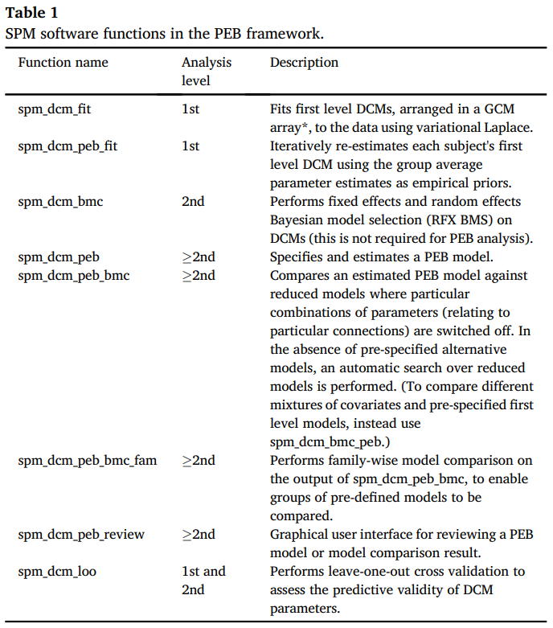
PEB is implemented in the SPM12 Toolbox
First-level estimation with empirical priors
Gives us - model evidence (quality)
- group parameters
Performs greedy search over entire model space

Slide 27


Put the «E» in PEB
models
models
models
subjects
spm_dcm_fit
spm_dcm_bmr
spm_dcm_peb
Repeat
PEBs
$$θ_{i}^{\left(2\right)}$$
$$F^{(2)}$$
Free energy
to compare
models
Models with
empirical priors
spm_dcm_peb_fit
Notes:
What ist empirical about this framework?
Here is a schematic of how the DCM analysis will work on a gruop level. Each square represents a model, empty squares are unfitted models, filled squares are fitted models.
We first define the full model (the first column) for all subjects (rows). Then we estimate the connectivity parameters for each subejct. With a technique called Bayesian model reduction, nested models can be estimated rapidly.
For instance, to pull subjects’ parameter estimates out of local minima, the first level model estimation can be re-initialized multiple times, using the group-level posteriors from the PEB model as empirical priors for each subject (Friston et al., 2015).

Slide 28
DCM example: PEB group analysis
  Inference based on Bayesian model selection
    What is the model architecture that describes my data best?
    Compares different hypotheses about model structure
    You can also test families of models
  Inference based on Bayesian model averaging
    If there is no clear winner…
    Average models weighted by their posterior probability
    Look at connectivity estimates between regions
    Uses a “greedy search” algorithm
  Metric? – The free energy

Slide 29
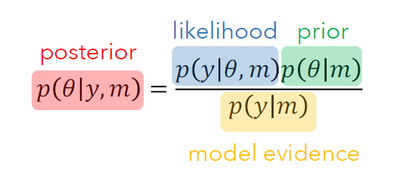
Free energy as approximated model evidence
Model evidence is the marginal likelihood across the entire parameter space
„Given all possible parameter values, how well can the model describe the data?“
For complex models (like DCM) often impossible to derive analytically
( = no formula available) → need for an approximation
Notes:
complexity higher the more independent prior parameters
complexity higher the more dependent posterior parameters
complexity higher the more posterior deviates from prior mean

Slide 30
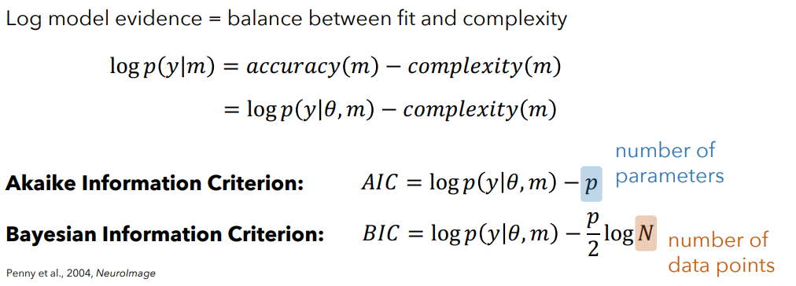

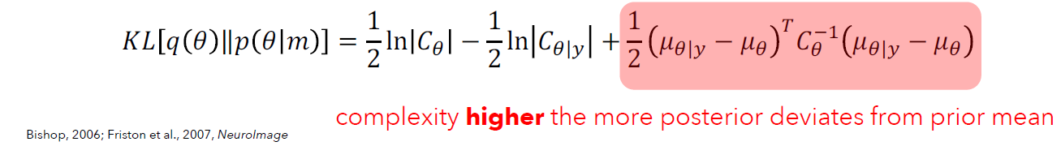
Free energy as approximated model evidence
Free Energy:
Stefan Frässle
Notes:
complexity higher the more independent prior parameters
complexity higher the more dependent posterior parameters
complexity higher the more posterior deviates from prior mean
Trade off between model fit an model complexity

Slide 31
DCM example: PEB group analysis
  Build a model to test the overall connectivity changes across the entire group during the task
AUC
STS
PUT
Associative
strength
?
VWFA

Slide 32
DCM example: 1. PEB Bayesian model selection
  Steps:
  Create a PEB model
    Specify 2nd-level design matrix
    Specify model space
  Invert model
  Perform model comparison
AUC
STS
PUT
Associative
strength
?
VWFA

Slide 33
DCM example: 2. PEB Bayesian model averaging with greedy search
  Steps:
  Create a PEB model
    Specify 2nd-level design matrix
    Specify model space
  Invert model
  Perform model comparison and remove parameters (FE with vs without)
AUC
STS
PUT
Associative
strength
?
VWFA

Slide 34
DCM example: Add a covariate to your design matrix
    To test for associations with a covariate or for group differences we can add regressors to the design matrix
    Should be limited to a reasonable amount …
    Are there group differences between typical and poor readers during the learning task?
AUC
STS
PUT
Associative
strength
?
VWFA

Slide 35
DCM example: Group differences
AUC
poor < typical
STS
PUT
Associative
strength
VWFA
Poor readers show a decreased coupling between VWFA and STS
compared to typical readers

Slide 36
DCM example: Leave-one-out cross-validation
  Refits the model n-1 times and excludes one subject at a time
  Can we predict the variable? (e.g. group membership)
  Is the effect large enough to be meaningful?

Slide 37
Questions?

